Slide 1
CrisprVi: a software for visualizing and analyzing CRISPR sequences of prokaryotes

Slide 2
What is CRISPR-Cas?
CRISPR-Cas System
Clustered Regularly Interspaced Short Palindromic Repeats-CRISPR-associated
Powerful gene editing tool to make precise changes in DNA of living organisms
Essential for bacterial adaptive immunity

Slide 3
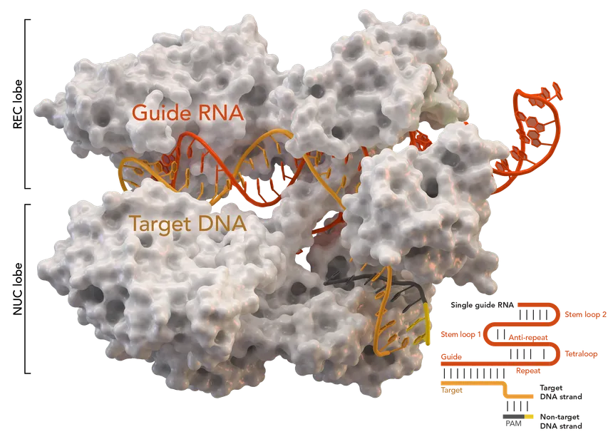

Slide 4
The Problem with CRISPR Visualization and Analysis
Comprehensive Tools
Investigate loci and sequences of DRs and spacers
Existing tools: CRT, PILER-CR, CRISPRFinder, etc.
Limitations of Current Tools:
Lack interactive and user-friendly visualization
Complexity and non-interactivity of Excel macros
Over-reliance on specific detection tools
Confusing visual outputs with complex datasets
Gap in the market
Need for an all-in-one tool to visualize, manipulate, and analyze CRISPR arrays effectively

Slide 5

Why use Python?
Extensive Bioinformatics libraries
Biopython: sequence analysis and data manipulation
Pandas: efficient data handling and analysis
Matplotlib & Seaborn: powerful data visualization tools
Seamless integration with existing bioinformatics tools
Large, active community
Capable of handling large datasets efficiently

Slide 6





Python Libraries Used
Biopython: sequence analysis and manipulation
Pandas: efficient data organization and management
NumPy: handling large datasets
Matplotlib: creating visuals
Seaborn: high-level statistical graphics

Slide 7
Results
Successful development of a graphically interactive software
User can customize graphics for DRs/spacers
User can perform statistical analysis of the DRs/spacers on selected strains of interest
Flexible: allows user to choose CRISPR detection

Slide 8
My Thoughts
Address a gap in bioinformatics tools
Using Python ensures it is user-friendly
Contributes to advancements in genetic research and biotechnology

Slide 9
References
Jia, B., Zhang, X., Jiang, Q., Wang, Z., Zhang, Y., Hu, Y., & Wang, Y. (2022). CrisprVi: a software for visulaizing and analyzing CRISPR sequences of prokaryotes. BMC Bioinformatics, 23(1), 257. https://doi.org/10.1186/s12859-022-04716-9

Slide 10
Questions?

